Slide 1
Model View Matrix and its implementation
Sang Il Park
Department of Software
Sejong University

Slide 2
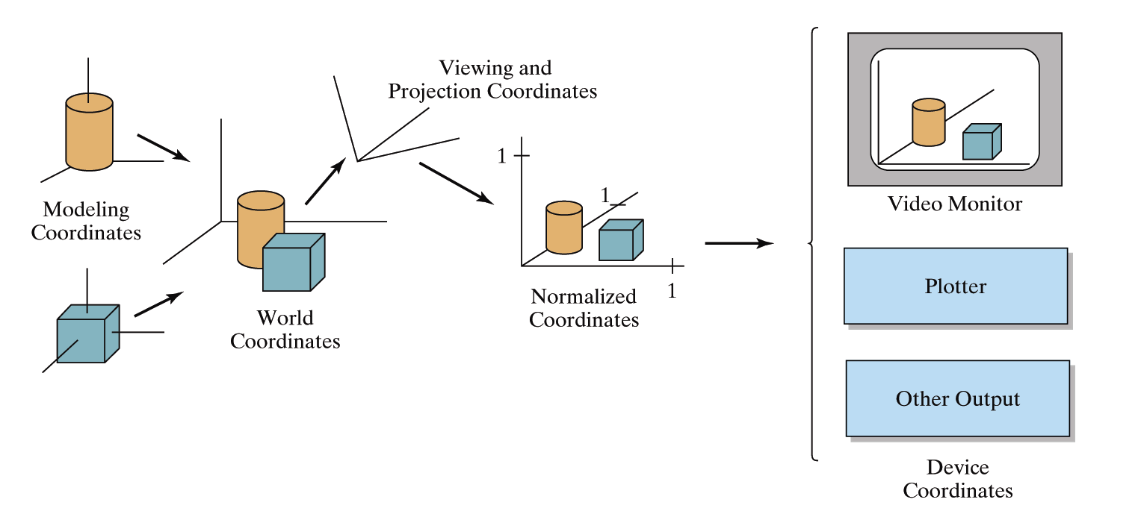
OpenGL Geometric Transformations
Consecutive Transformations
in OpenGL Pipeline
Model Transform
: local to world
View Transform
: world to camera
Projection Transform
: camera to screen

Slide 3
Topics
Local to World Coordinate Transform
Camera Positioning

Slide 4
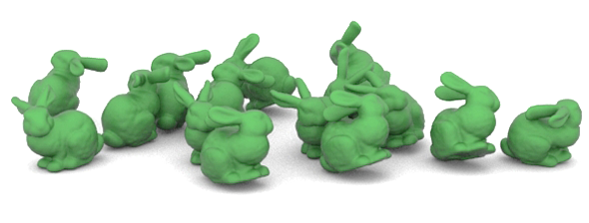
Instance Transformation
Instances can be shared across space or time
Write a function that renders the object in “standard” configuration
Apply transformations to different instances
Typical order: scaling → rotation → translation

Slide 5
풍차 만들기
0.8
y
y
0.25
x
1
z
0.5
0.4

Slide 6

로보트 팔 만들기

Slide 7
로보트 팔 만들기2

Slide 8
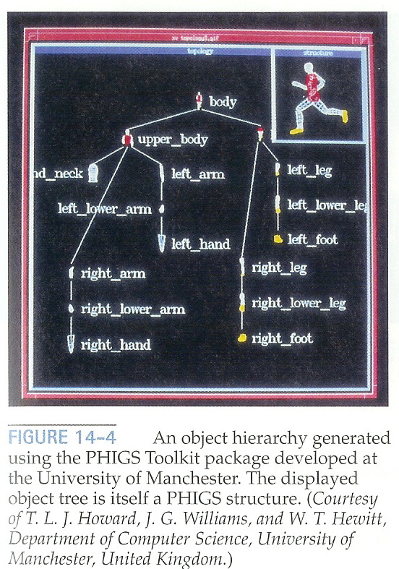
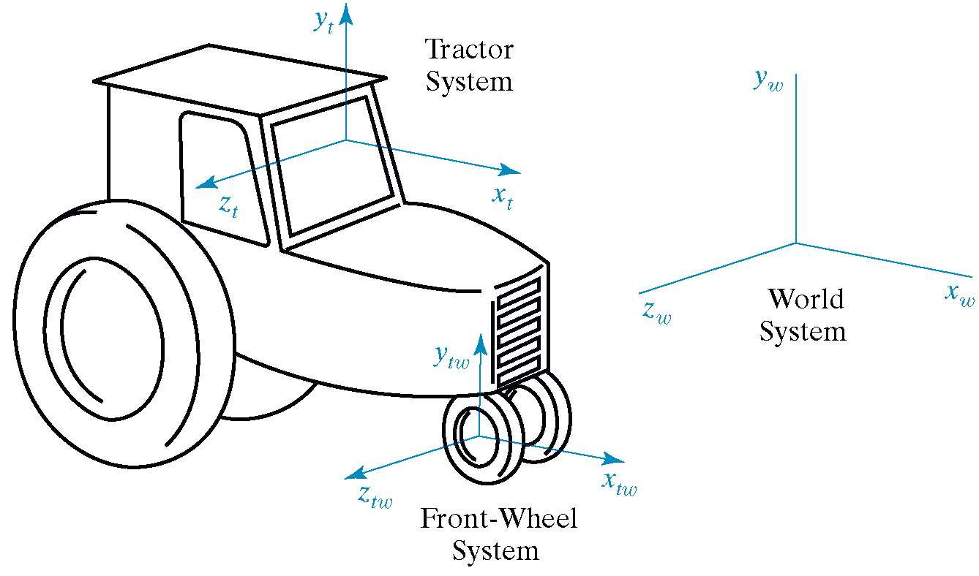
Hierarchical Modeling
A hierarchical model is created by nesting the descriptions of subparts into one another to form a tree organization

Slide 9
OpenGL Matrix Stacks
(OLD)
Stack processing
  The top of the stack is the “current” matrix
  glPushMatrix(); // Duplicate the current matrix at the top
  glPopMatrix(); // Remove the matrix at the top

Slide 10
Matrix Stacks by your own
We emulate Matrix Stacks by using:
  Linked List such as std::list or std::deque
  Or a tree structure for more generality.

